Slide 1
Introversion
Kelsey Newman

Slide 2
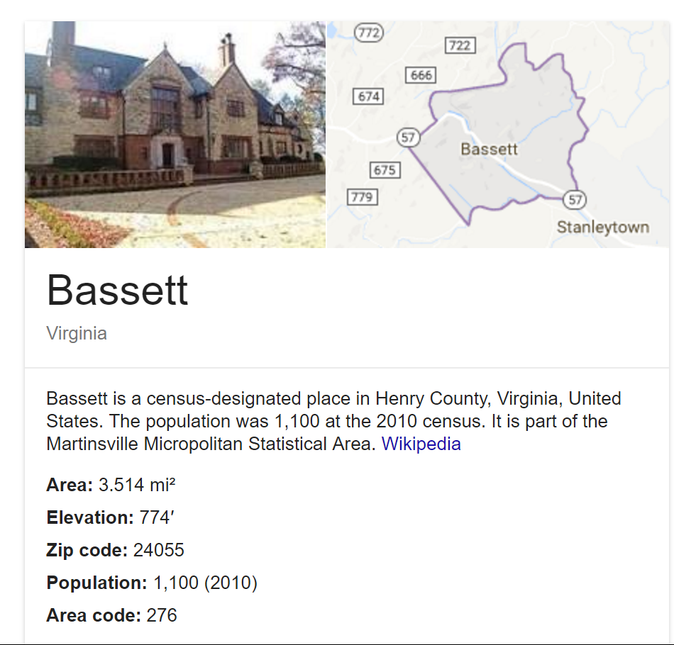
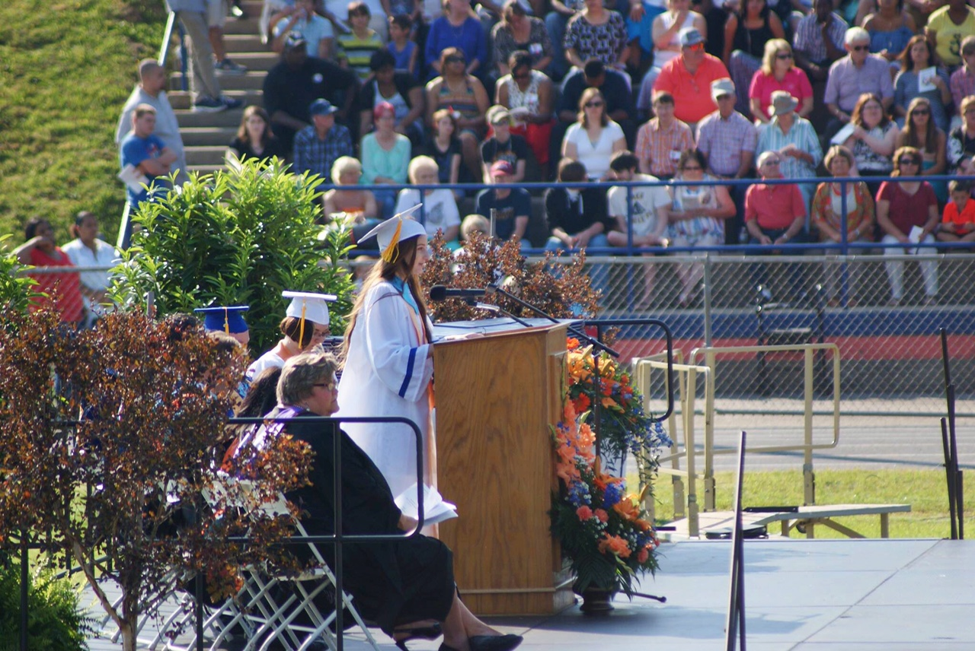
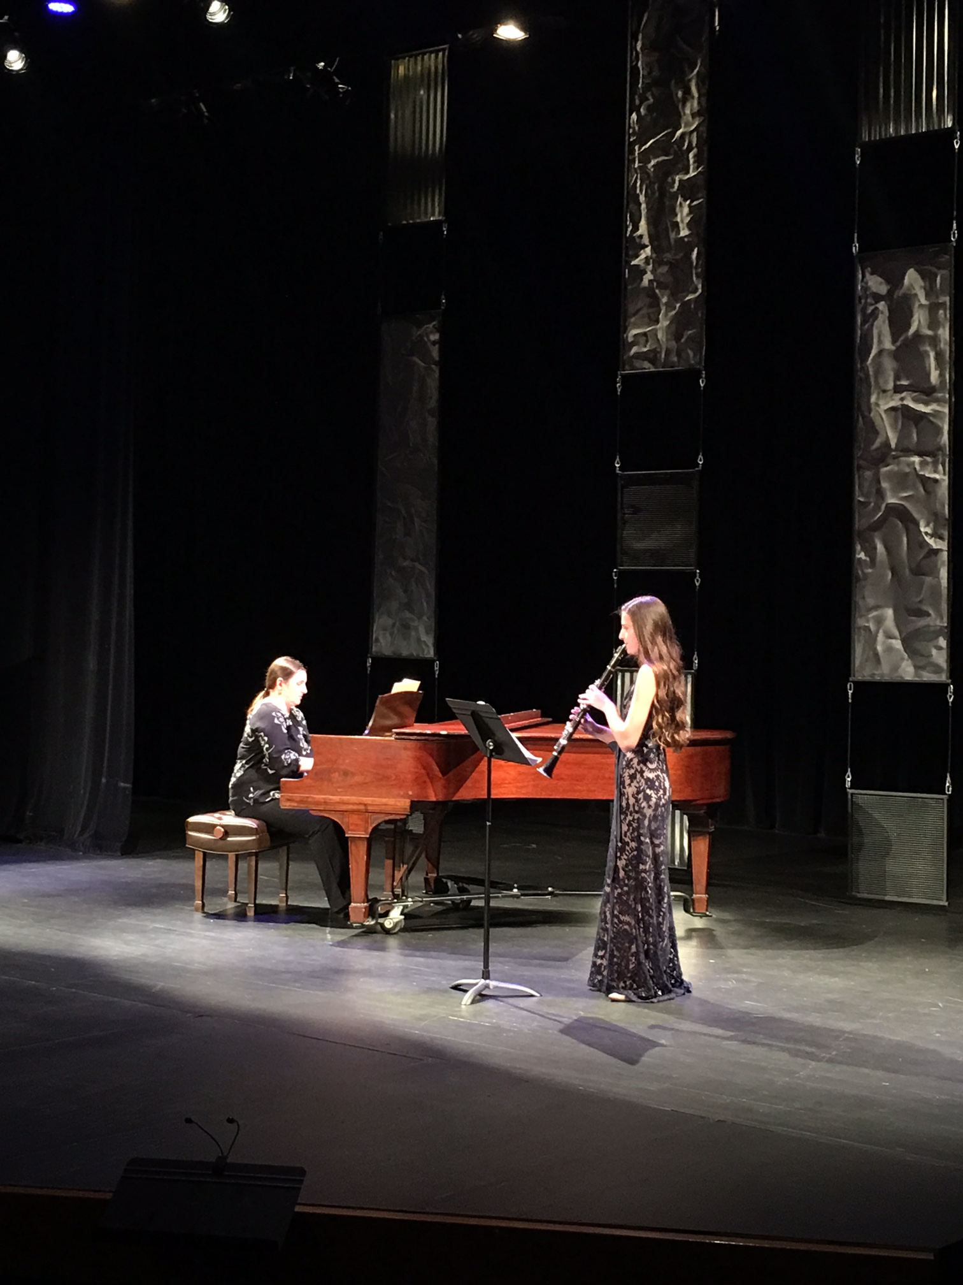
https://en.wikipedia.org/wiki/Bassett,_Virginia
https://characterclearinghouse.fsu.edu/
https://en.wikipedia.org/wiki/Relay_For_Life

Slide 3
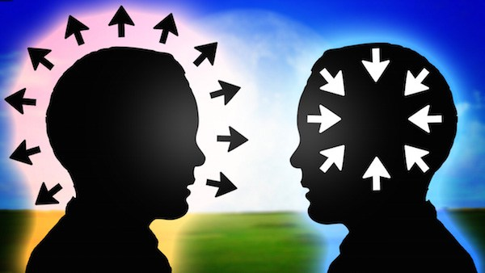
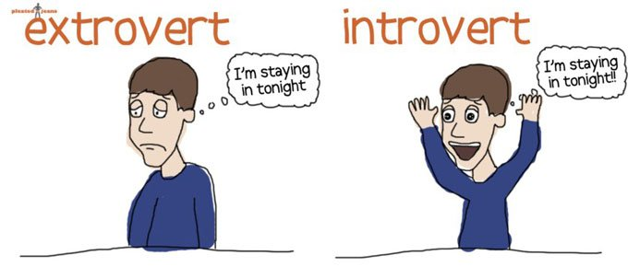
DEFINITIONS
Introverts
exaggerate thought process
recharge through time alone
“reserved”
“passive”
Extraverts
Recharge by making social contacts
“bold”
“social”
NOT ALL INTROVERTS ARE SHY

Slide 4
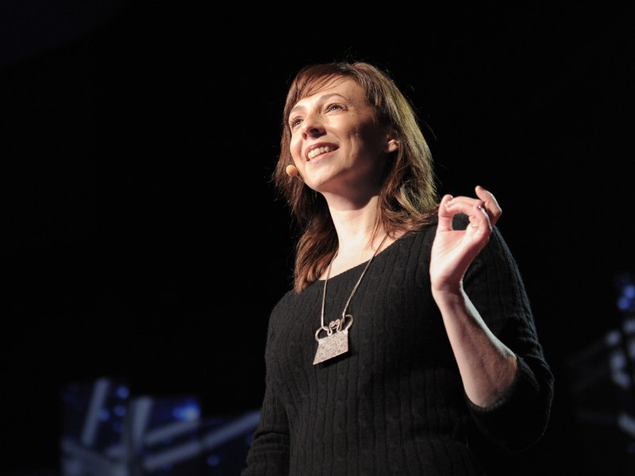
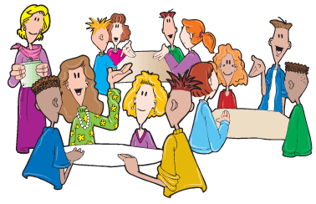
Introversion in Academia
Susan Cain “The Power of Introverts”
Focus on discussion/collaboration
Colgate University study
View of life as “perpetual performance”
Tips for educators
Advanced notice of expectation
Breakout sessions
Encourage active listening and reflection
https://www.ted.com/talks/susan_cain_the_power_of_introverts

Slide 5
In Society
“Selfish”
“Unwilling”
Lack of encouragement…lower self-concept
“Introverts would repay a society a hundred-fold if their human relationship skills and the confidence to function productively with people were sufficiently developed.” Henjem (1982)
Homogeneous society

Slide 6
Personality in Music
Introverts- reflective, complex
Extraverts- pop and hip-hop
Choir
Brass and percussion
Woodwinds
Musical career

Slide 7
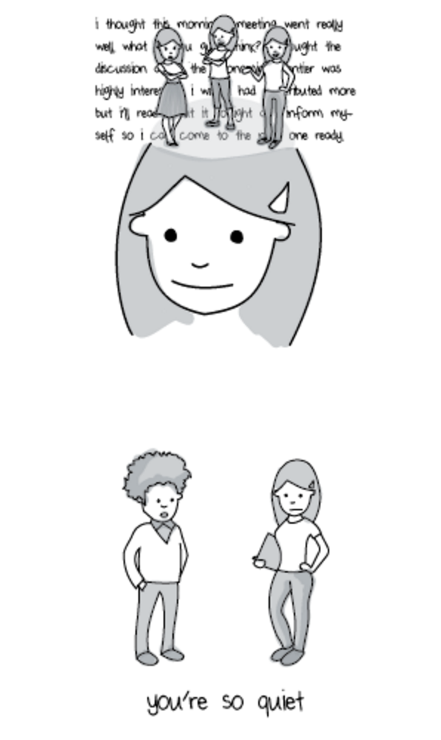
I
School
Social settings
Music
E

